Slide 1


MINOR IN PRODUCT DEVELOPMENT INTERNSHIP
Hologlyph Bots
Automating the process of Road-Marking
Project Report
Alok Raj Siddharth Gorai
22JE0091 22JE0951

Slide 2
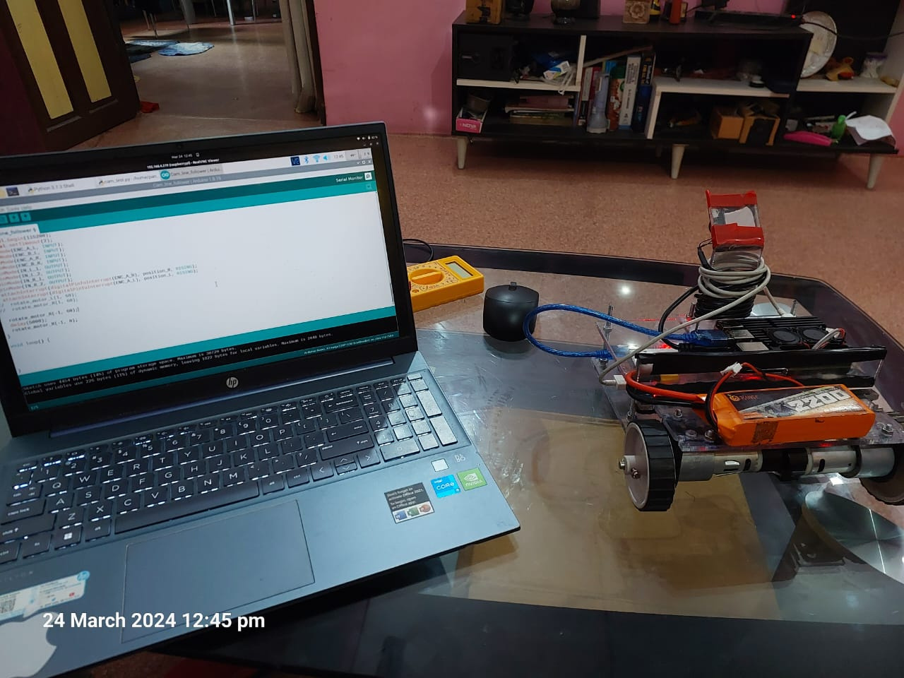
Objectives
Create an autonomous robot for drawing markings on the ground.
Remote Wireless communication via the use of Wi-Fi.
Vision based feedback PID control system.
Multi-purpose application of the robot including manual remote control.

Slide 3


Methodology
Aruco
Detection
Image Processing
Inverse Kinematics
PID Controller
Actuators
ROS2, Rasp Cam
OpenCV, Rasp 4
Control Loop
Setpoint Navigation
Servos
The overhead camera captures the image of the robot and publishes it to the mini-computer via a ROS2 connection
The mini-computer processes the image, detecting the aruco-marker placed on the top of the robot and determines the relative position of the robot with respect to some fixed reference and publishes this pose data.
The pose data is used for error calculations and cartesian speed determination using a PID control loop.
The cartesian speed is used for inverse kinematic calculations for the individual motor speeds.
The motor speeds are taken by the micro-controller which then actuates the specific motors.

Slide 4
Prototype Progress
Hardware
Testing
Hardware Integration
Line Detection
PID controller
Spray Mechanism

Slide 5


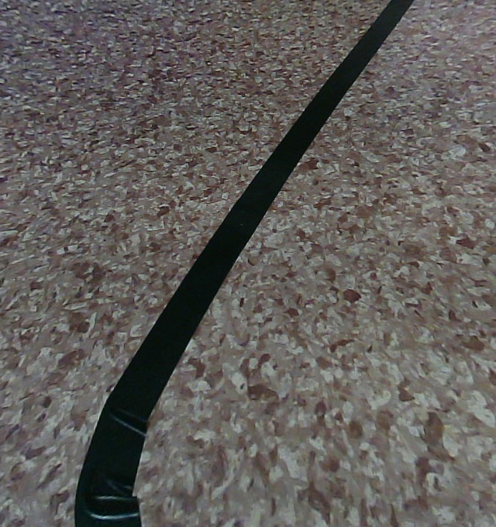
Line-Detection Algorithm
Contour centroid extraction
Original
HSV Color Detection
y0
T
y1
y2
y3
x3
x2
x1
x0

Slide 6
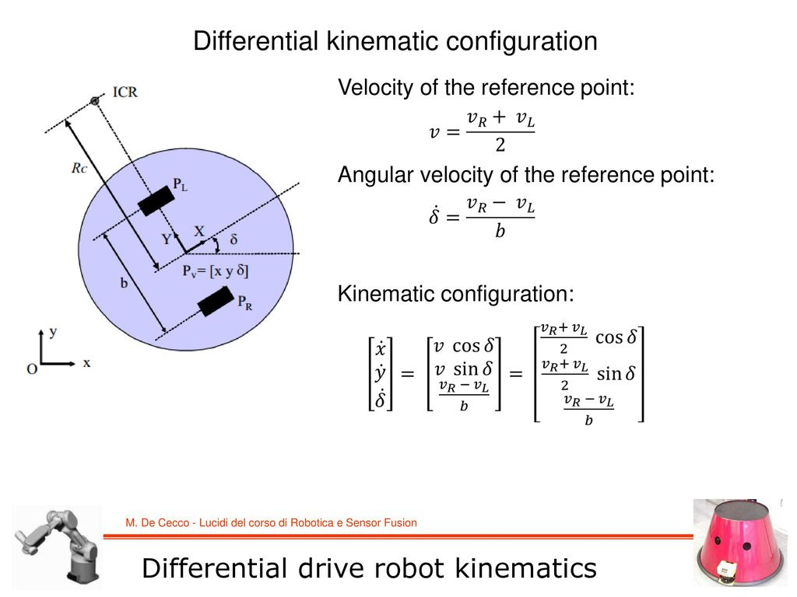
Differential Drive
Differential drive robots have 2 Degrees of Freedom.
Linear forward velocity
Angular Velocity
To control these DoFs, we have 2 PID loops.
PIDx: maintains the orientation of the robot on the line.
PIDy: maintains the forward speed of the robot.

Slide 7
Problems
Issues
The processing speed of Raspberry Pi 4 is lacking. It only gets around 12 FPS with the current line detection algorithm.
The Line-Detection Algorithm is error prone for intersecting lines. So A Machine Learning approach will be followed in the future.
The DC motors have a dead bend region in them, i.e, they do not activate below a certain voltage. Continous rotation servos may be a better alternative.
The chassis design is also lacking as the centre of mass is not between the motors. A turtlebot like chassis may be better.

Slide 8
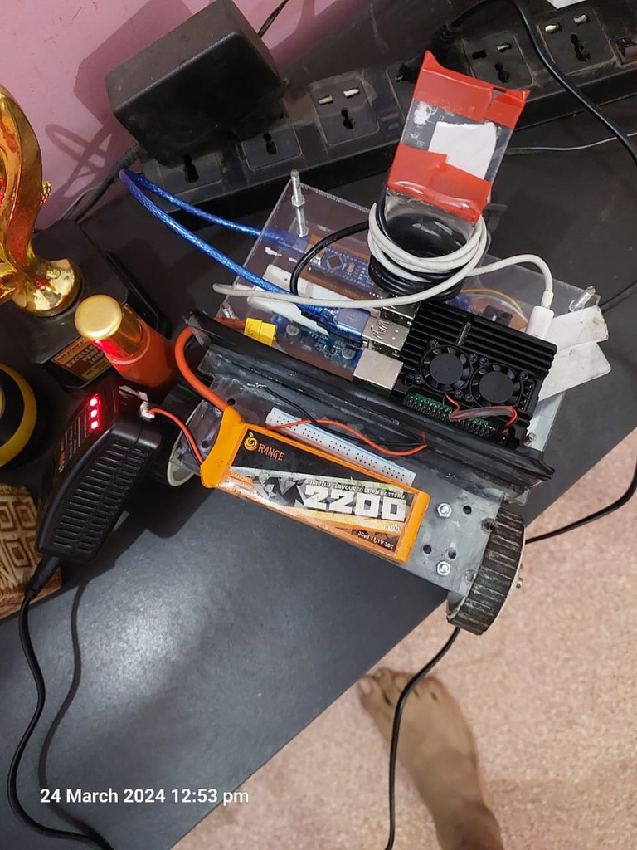
Current Deliverables
Autonomous robot for following a line on the ground or markings on roads.
Vision based feedback control system.
Remote control capability with the ease of smartphone control.
Charging

Slide 9

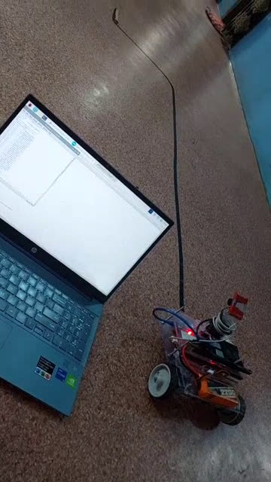
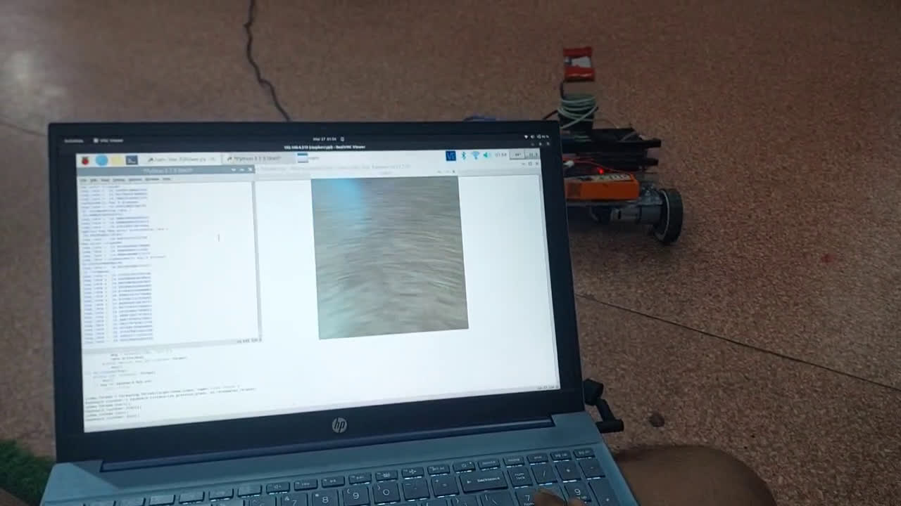
Autonomous Mode
Manual Mode
Demonstrations

